Slide 1

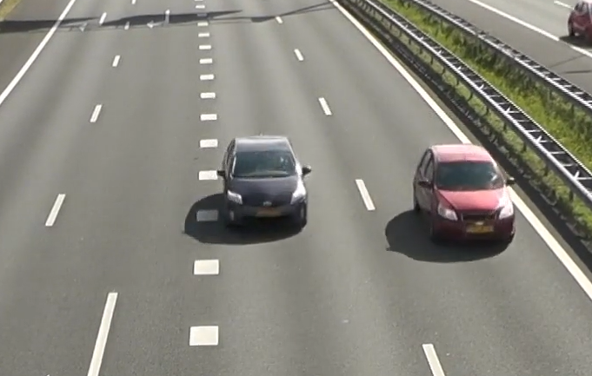
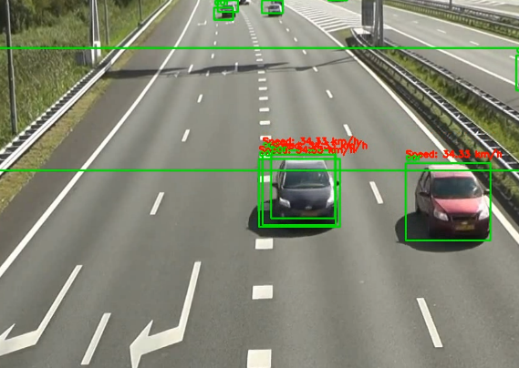
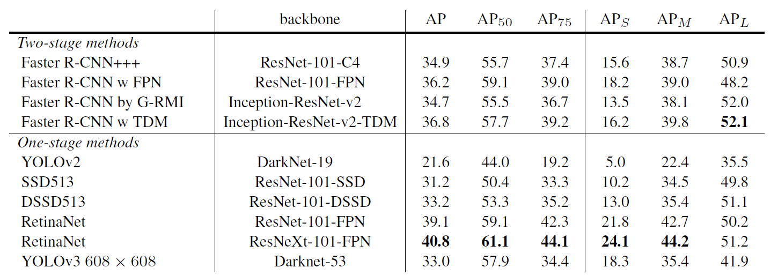
Deep Learning Based Vehicle Classification, Tracking and Speed Estimation Systems
Team ID: 82 Supervisor: Prof. Ardhendu Kundu Student Name :Chaitanya Anand Roll No.: 9 Student Name: Arkadeepto Majumder Roll No.: 35
Introduction
It displays speeds, bounding boxes, and labels on the video. for traffic monitoring
Employing multi-object detection, non-maximum suppression, and frame-by-frame processing, the script demonstrates practical computer vision and object detection
Discussion
Rapid urbanization and technological advances contribute to severe traffic congestion. Traditional traffic management is insufficient. Automated systems using IoT and machine learning, like CNNs and YOLO, offer efficient vehicle tracking and classification solutions
The project explores modern traffic systems using deep learning and traditional methods. Challenges include accuracy in real traffic situations, manual analysis inefficiencies, and dataset imbalances. Implemented YOLOv3 with TensorFlow for real-time traffic surveillance, addressing urban growth and technological impacts. Future prospects involve improving classification accuracy and integrating diverse sensors for enhanced vehicle detection.
Objectives and Challenges
Results
Traffic Challenges: Addressing urban growth and tech impact, study aims congestion solutions [1]
Modern Tech Usage: Implementing YOLOv3 with TensorFlow for real-time traffic surveillance.
Enviro-Tech Challenges: Traditional systems struggle with varied environments and manual analysis inefficiencies.
Accuracy Challenges: Deep learning faces accuracy hurdles in real traffic, image definition, and datasets.
Conclusion and Future Scope
Despite advancements, challenges persist in manual labeling efforts and achieving 100% accuracy. Integrating multiple sensors and embracing autonomous traffic management[4] are promising directions. In conclusion, we categorized vehicle classification into traditional, deep learning, and modern methods, addressing limitations and suggesting future research directions.
Fig. 1: The raw footage
Fig. 2: : After detection, classification and speed measurement
Our Approach
References
Implemented in Python, the project uses OpenCV and YOLO for vehicle detection and speed calculation.
YOLO, loaded with pre-trained weights and the COCO dataset, analyzes the 'veh2.avi' video stream, saving results to 'result.mp4'. The script processes frames, detects vehicles, and calculates speeds between predefined lines.
Two lines mark speed calculation positions. The script tracks when vehicles cross lines, calculating speeds based on real-life distance.[3]
.
Muhammad Tahir Masood PhD, P. E. "Transportation problems in developing countries Pakistan: a case-in-point." International Journal of Business and management 6.11 (2011): 256.
Ahmad Arinaldi, Jaka Arya Pradana, Arlan Arventa Gurusinga, “Detection and classification of vehicles for traffic video analytics”, Procedia Computer Science, Volume 144, 2018, Pages 259-268, ISSN 1877-0509
Lin, Cheng-Jian, Shiou-Yun Jeng, and Hong-Wei Lioa. "A real-time vehicle counting, speed estimation, and classification system based on virtual detection zone and YOLO." Mathematical Problems in Engineering 2021 (2021): 1-10.
17. M. Won, "Intelligent Traffic Monitoring Systems for Vehicle Classification: A Survey," in IEEE Access, vol. 8, pp. 73340-73358, 2020, doi: 10.1109/ACCESS.2020.2987634.
Table 1: Table showing average precision of different models

